Slide 1



Air Quality Index (AQI) Prediction using Python and Machine Learning

Slide 2

Learning Objectives
To understand the process of data cleaning and preprocessing for a real-world time-series dataset.
To apply a time-series forecasting model (Facebook Prophet) to predict an environmental metric.
To visualize and interpret the results of a time-series forecast, including trend and seasonality.
GOAL
The primary goal of this project is to build a predictive model that can forecast a key air quality indicator—Relative Humidity (RH)—using historical sensor data. This serves as a foundational step towards creating a complete Air Quality Index (AQI) prediction system.
Source :
https://github.com/Soumadip-das-003/Air-Quality-Index-AQI-Prediction-using-Python-and-Machine-Learning.git

Slide 3
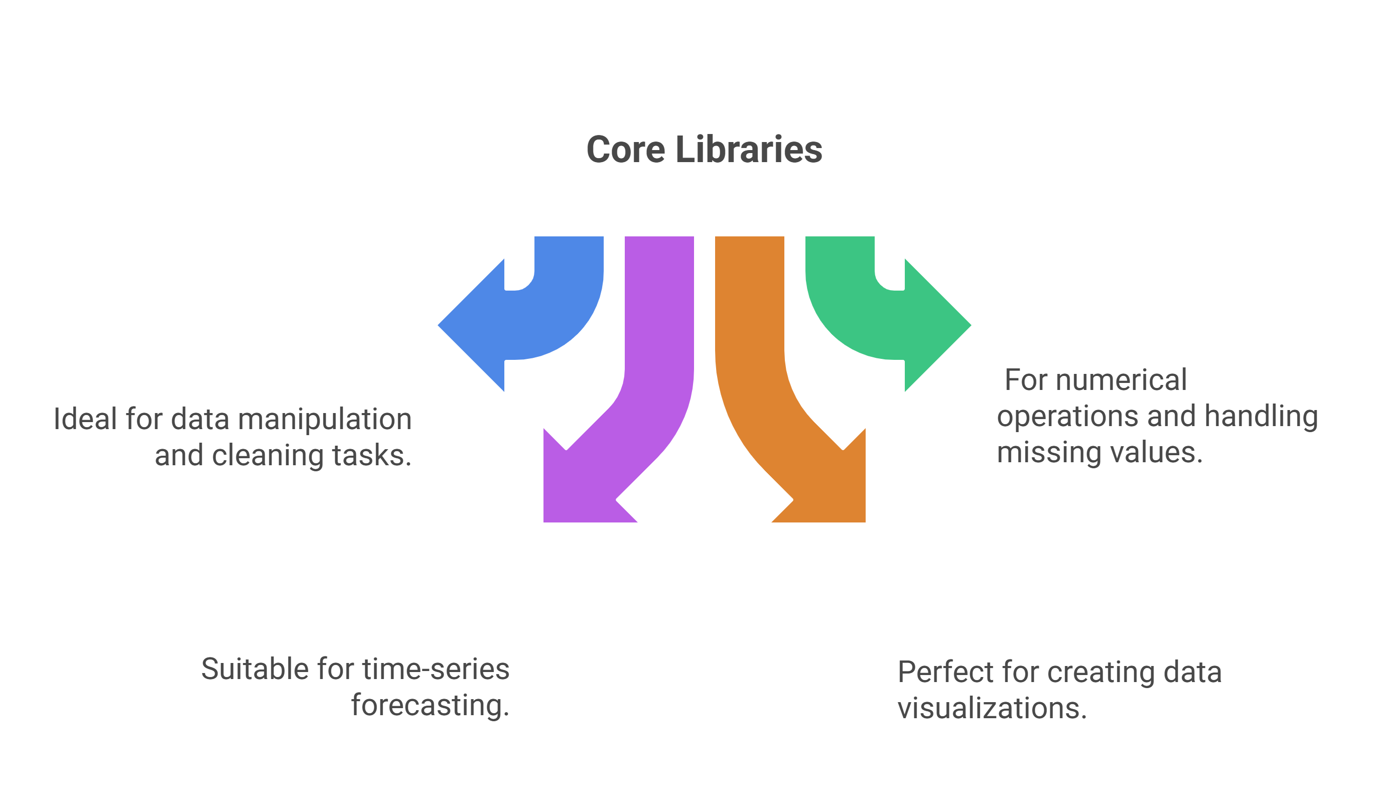





Tools and Technology used
Programming Language:
Python

Slide 4
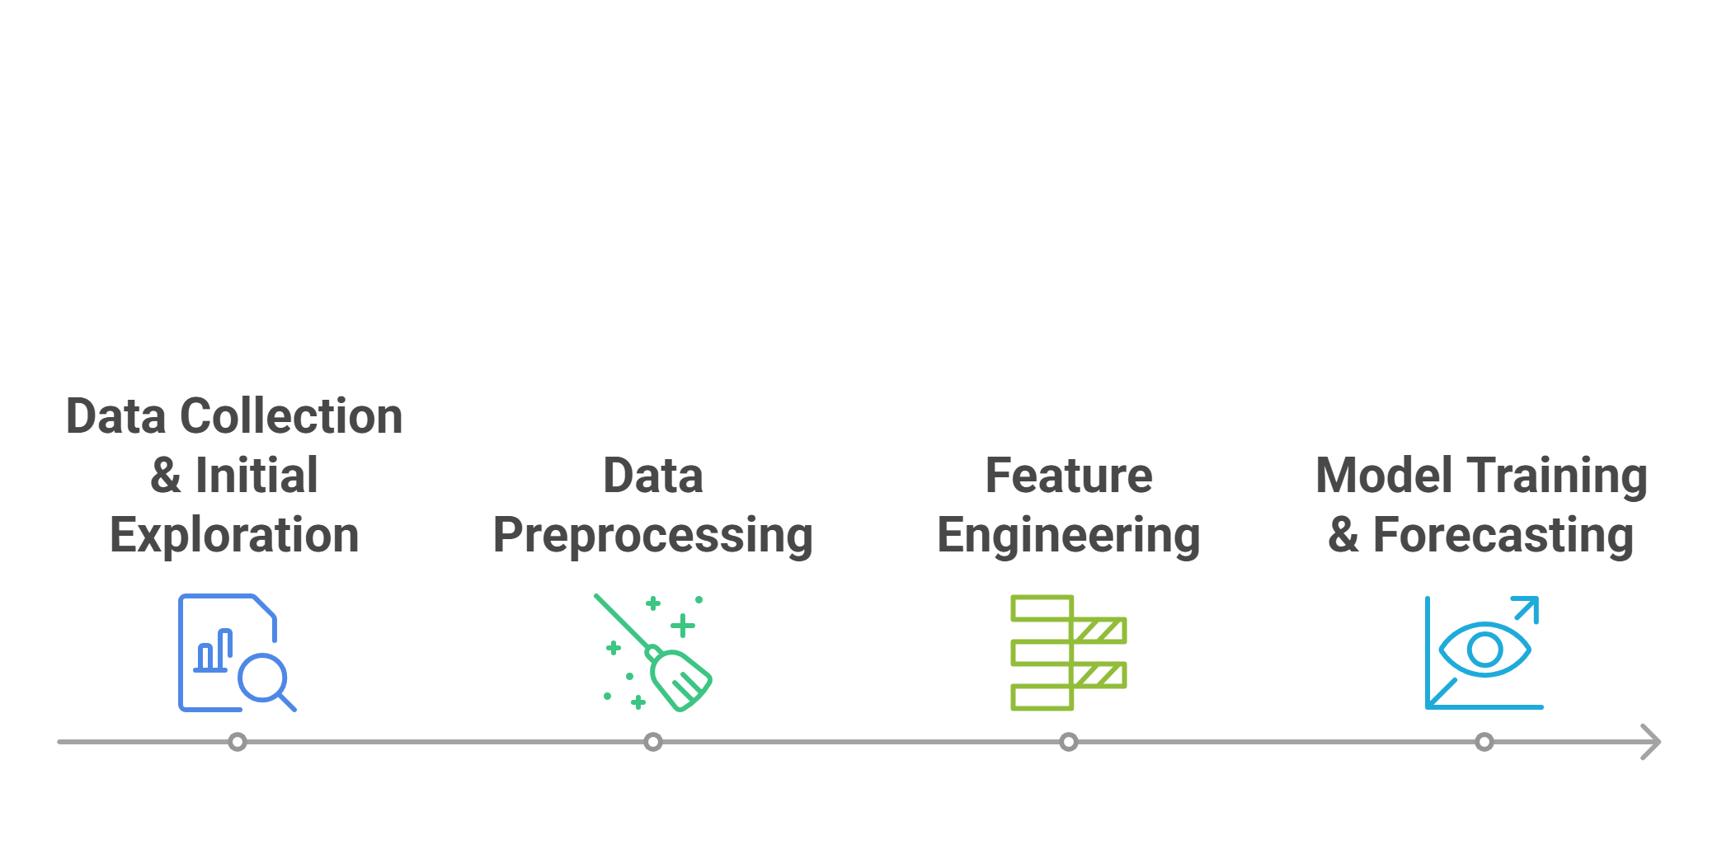
Methodology
The project was executed in the following phases:
The Air Quality UCI dataset was loaded into a Pandas DataFrame. The initial structure and data types were examined.
Corrected the data import by specifying the semicolon delimiter and comma decimal separator.
Identified that missing values were represented by the integer -200.
Replaced all -200 values with NaN (Not a Number) for proper handling.
Filled the NaN values using the mean of each respective column to create a complete dataset for the model.
The Date and Time columns were combined into a single datetime column (ds), which is required for the Prophet model.
The Relative Humidity (RH) column was selected as the target variable (y).
A Prophet model was initialized and trained on the prepared time-series data.
The trained model was used to generate a forecast for the next 365 hourly periods.

Slide 5
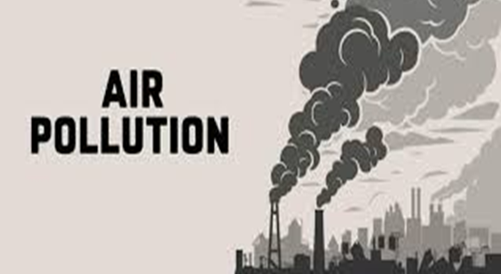
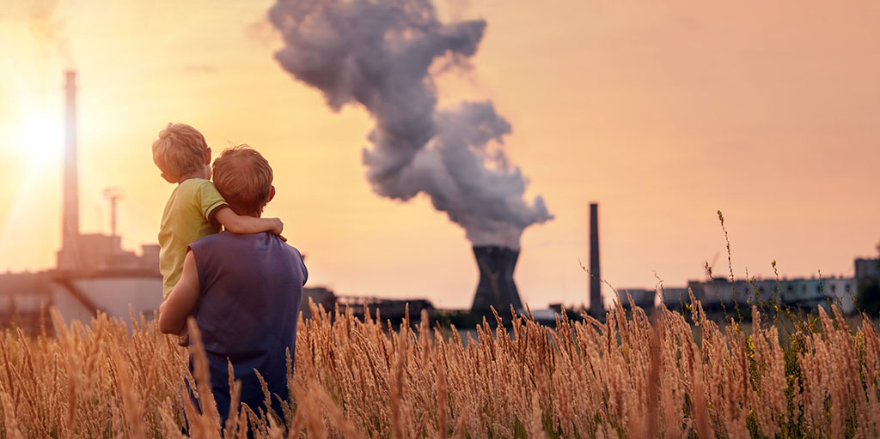
Problem Statement:
Air pollution is a critical public health issue, and the ability to predict the Air Quality Index (AQI) is essential for issuing timely warnings and protecting vulnerable populations. However, forecasting AQI is challenging because it relies on complex time-series data from multiple sensors. The primary dataset for this project, the Air Quality UCI dataset, presents a significant obstacle: it contains numerous missing values incorrectly encoded as -200, which can mislead a predictive model. The problem, therefore, is to develop a robust machine learning pipeline that can effectively clean this messy, real-world data and build an accurate time-series model to forecast future air quality trends.

Slide 6
Solution:
A time-series forecasting model was developed in Python to predict future Relative Humidity levels. The solution involved:
Cleaning the Data: A robust preprocessing pipeline was created to handle the dataset's specific formatting issues and impute missing values.
Applying a Specialized Model: Facebook's Prophet library, designed for time-series forecasting, was used to effectively capture the trends and seasonality (daily, weekly) present in the air quality data.
Generating Visualizations: The model's output was visualized to clearly show the predicted trend and compare it with historical data.

Slide 7
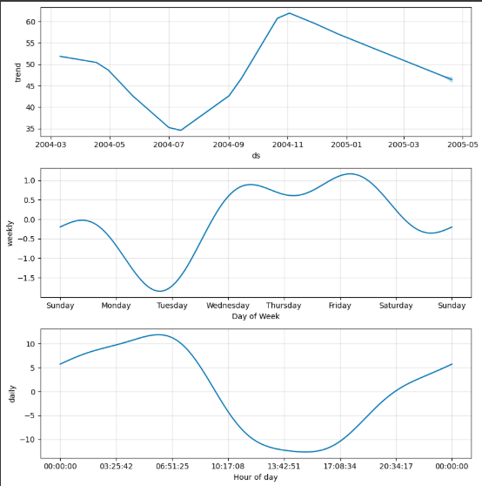
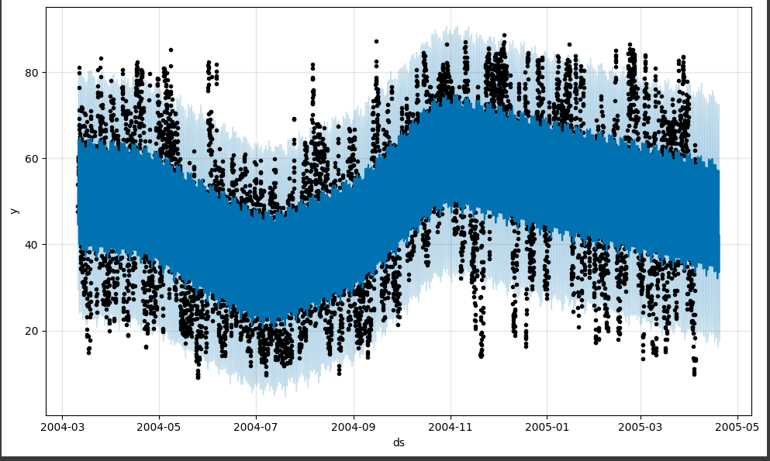
Screenshot of Output:
The model generated two key visualizations:
Forecast Plot: This plot shows the historical data (black dots) against the model's predictions (blue line). The light blue shaded area represents the confidence interval of the forecast.
Components Plot: This plot breaks down the forecast into its underlying components, revealing the overall trend and the weekly and daily seasonality patterns identified by the model.

Slide 8
Conclusion:
This project successfully demonstrates the use of Python and the Prophet library to build a time-series model for air quality prediction. The model effectively handled a challenging real-world dataset and produced a reasonable forecast for Relative Humidity. This work establishes a strong baseline that can be expanded in the future to predict multiple pollutants and calculate a comprehensive AQI score, providing a valuable tool for environmental monitoring.
~Thank You

